Slide 1
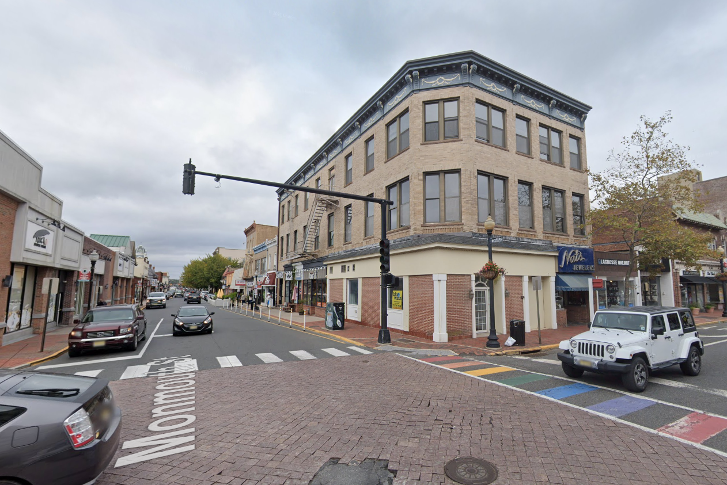


RED BANK RIVERCENTER
RED BANK PARKLET
CORNER OF MONMOUTH STREET AND BROAD STREET

Slide 2
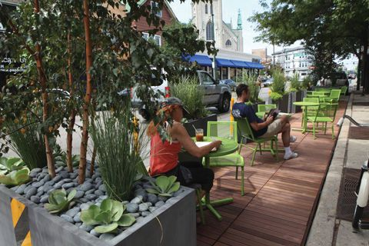
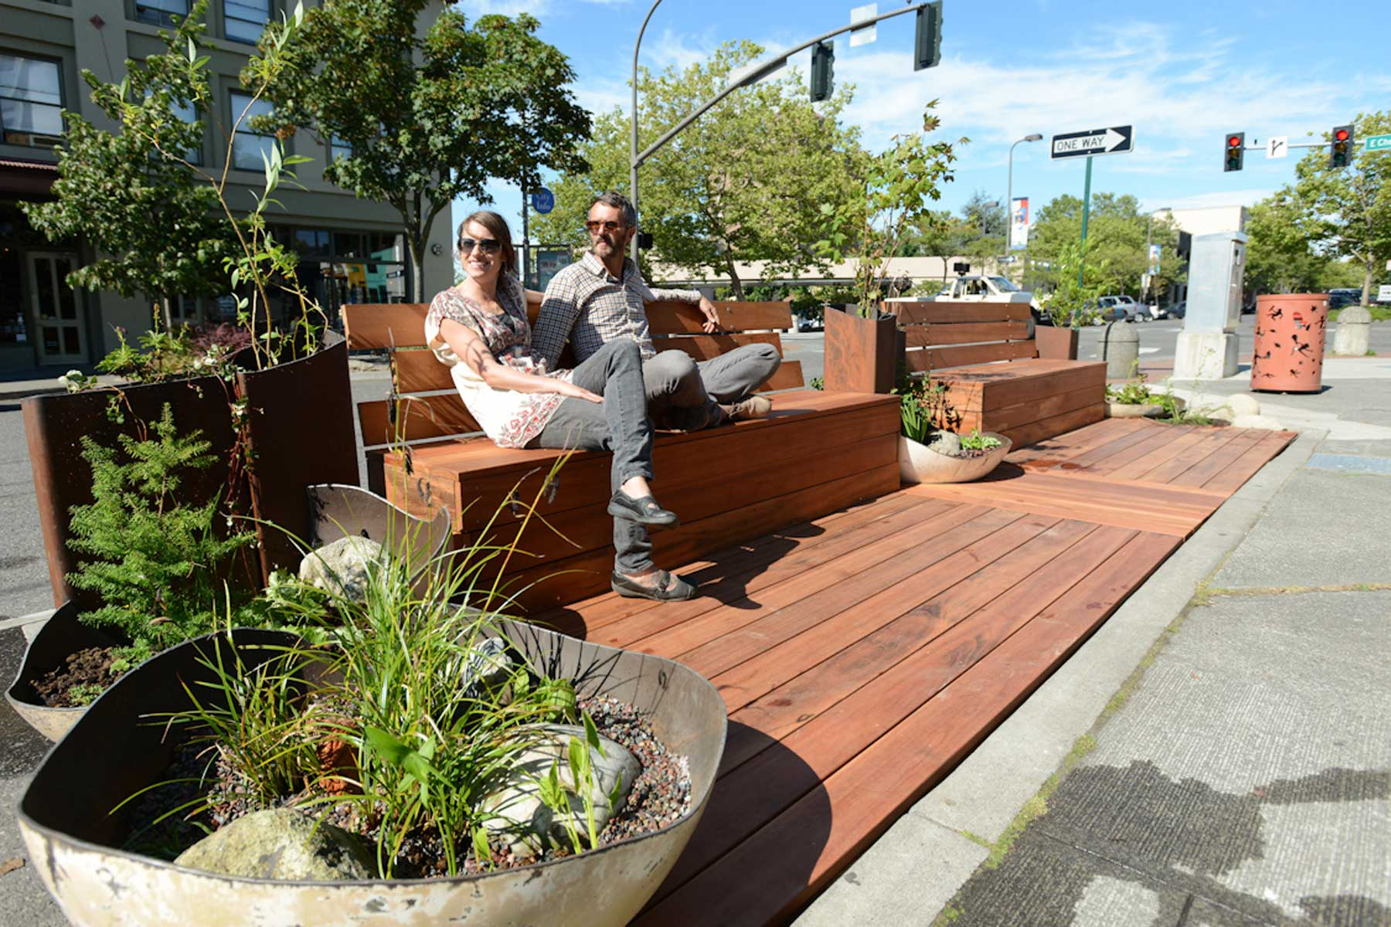
WHAT IS A PARKLET?
Parklet is a small public space that converts part of a street or parking area into a pedestrian-friendly environment.
Designed to provide additional seating, greenery, and recreational space in urban areas.
Benefits:
  Enhances walkability and pedestrian experience.
  Encourages social interaction and community engagement.
  Contributes to beautification of urban environments.
  Supports local businesses by increasing foot traffic.

Slide 3
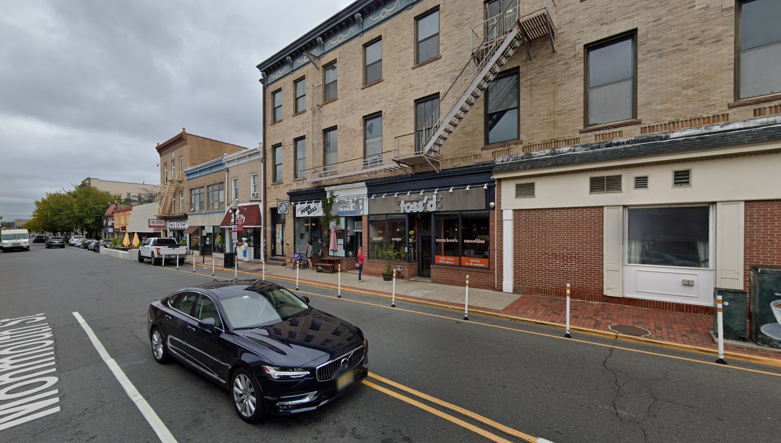
RED BANK PARKLET
OVERVIEW
Red Bank RiverCenter applied and secured $30,000 MSNJ District Transformation Grant for parklet design and installation.
Red Bank RiverCenter proposed the use of the area behind the flexible delineators along Monmouth St.
Red Bank RiverCenter tasked ENGenuity Infrastructure with the civil design and Danielle Boyle with the landscape design.
Red Bank RiverCenter requests the use of one parking spot.

Slide 4
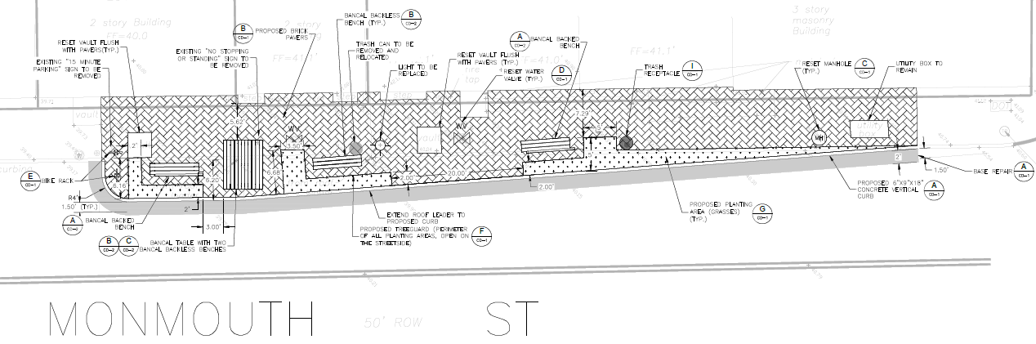
RED BANK PARKLET FEATURES
Parklet Curb extends to 2’ back from the existing yellow line and 6.75’ at its largest width.
The curb extension is limited by a NJ Transit Bus turning template since there is a NJ Transit Bus Stop located here.
NJ Transit agreed to a 20’ open space for the bus to pick pedestrian up allowing for ADA access.
Parklet includes Benches, Tables, Brick Pavers, Bike Racks, Trash Cans, Lights and beautiful Plantings.
Includes removal of flexible bollards and signs.

Slide 5
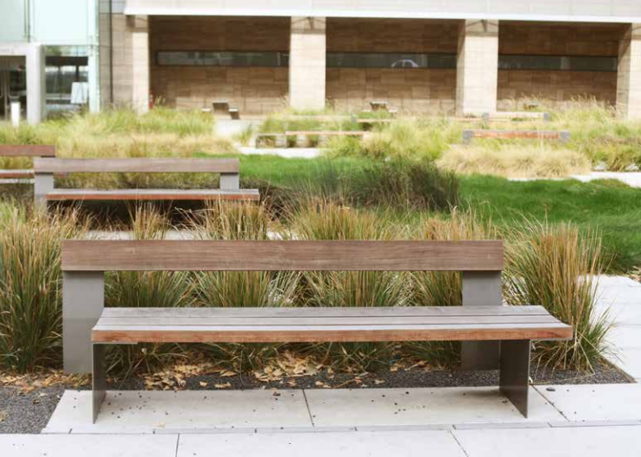
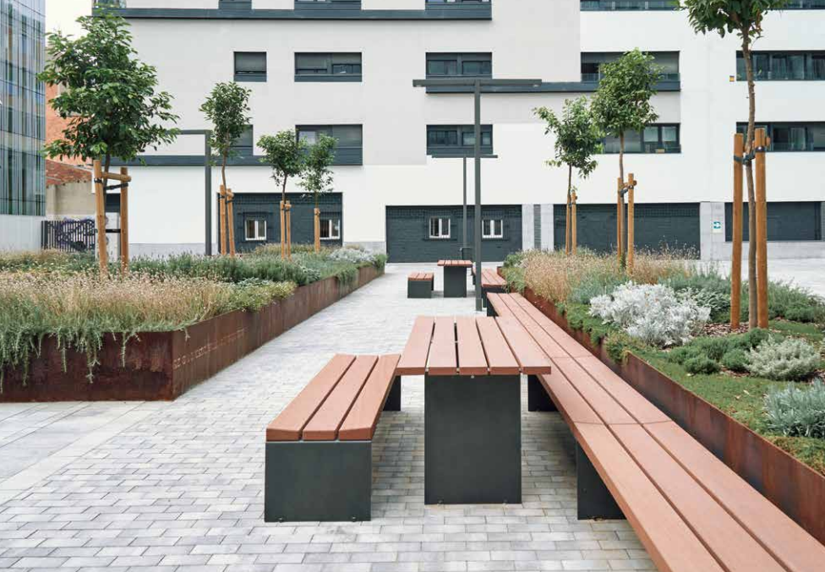
RED BANK PARKLET – TABLE AND BENCHES
Parklet Benches are Bancal Style Backed (2) and Backless (1) Benches manufactured by Landscape Forms.
Parklet Table is Bancal Style ADA compliant Table (1) manufactured by Landscape Forms.
The wood is IPE Wood and frame is powder coated Stormcloud metallic (Dark Grey).

Slide 6
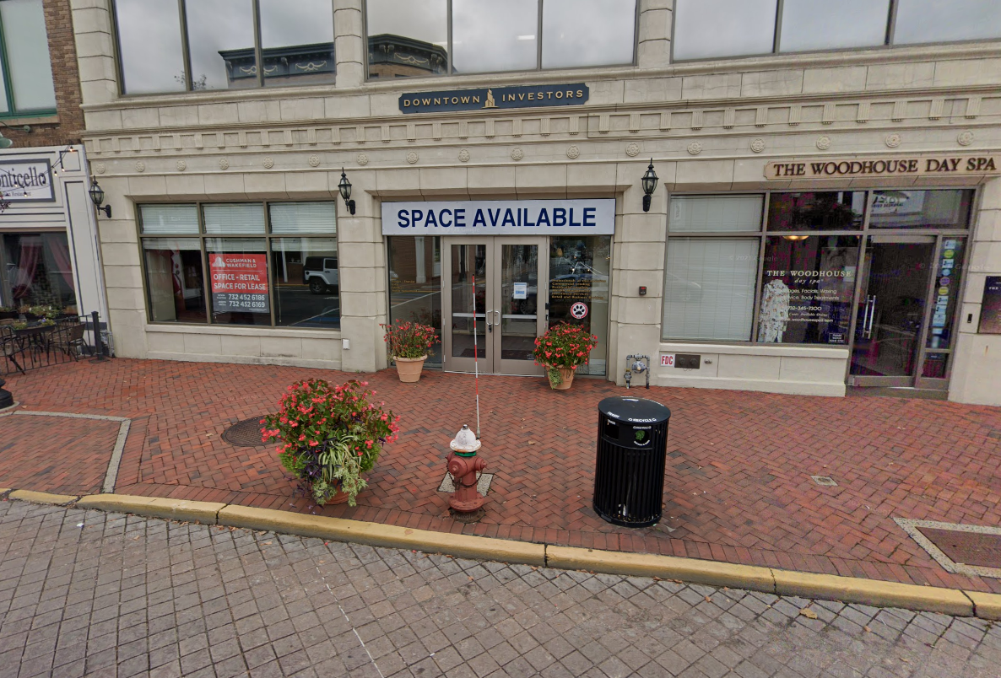
RED BANK PARKLET – PAVERS, BIKE RACK, TRASH CAN, LIGHTING
Parklet includes brick pavers in a running bone pattern.
Parklet includes 2 bike racks powder coated black manufactured by Dero.
Brand new trash can
Brand new light pole

Slide 7
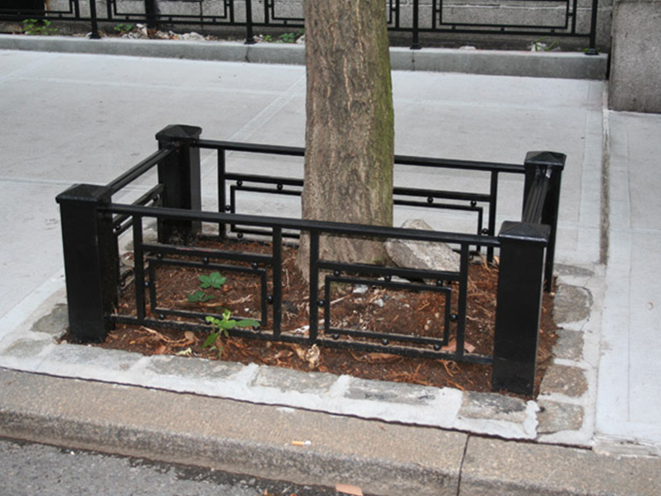
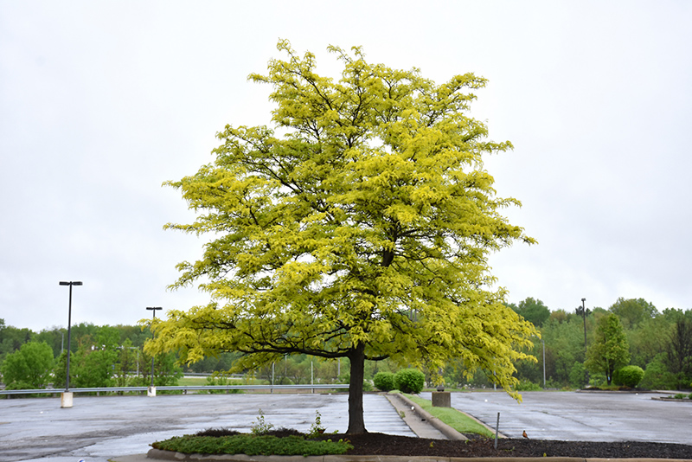
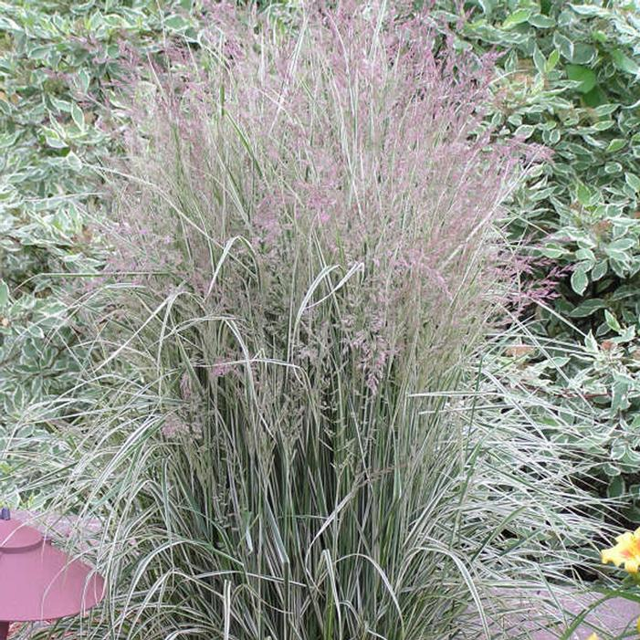
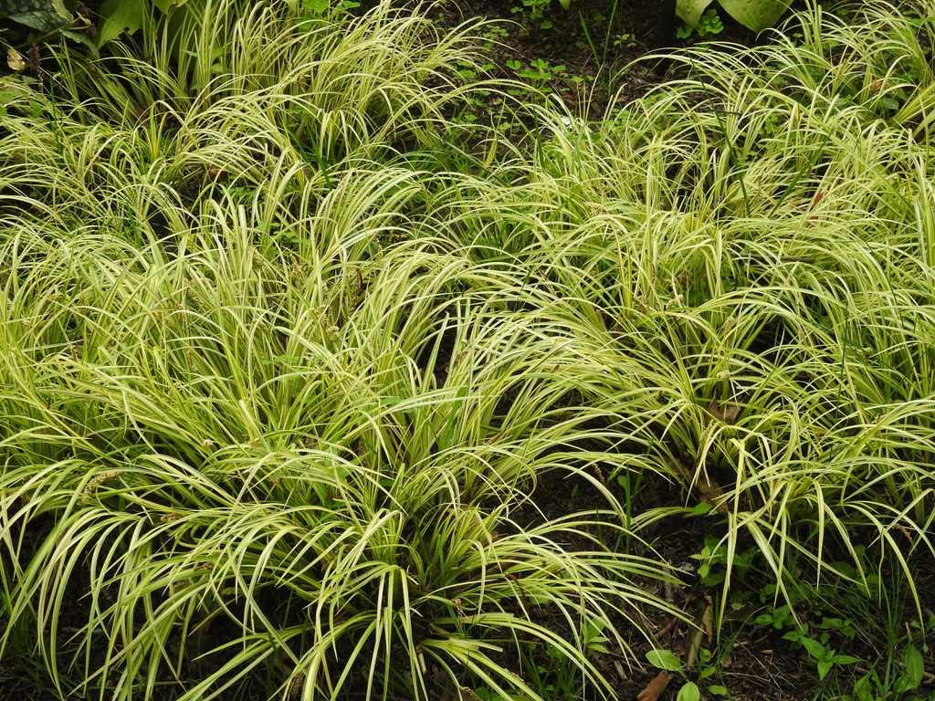
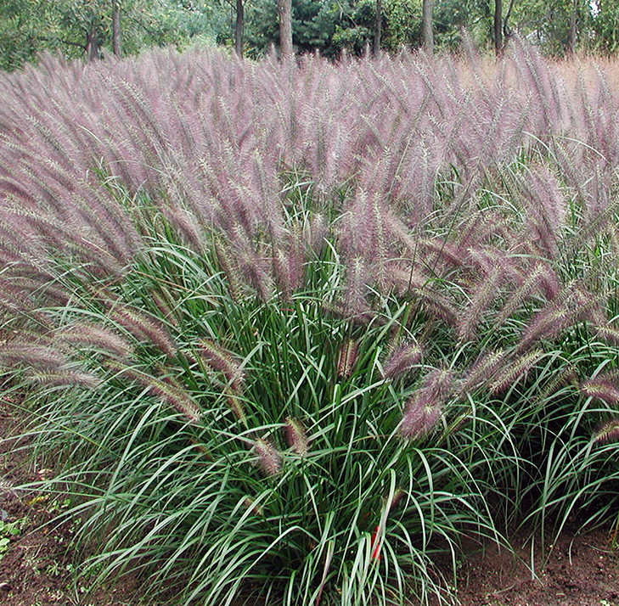
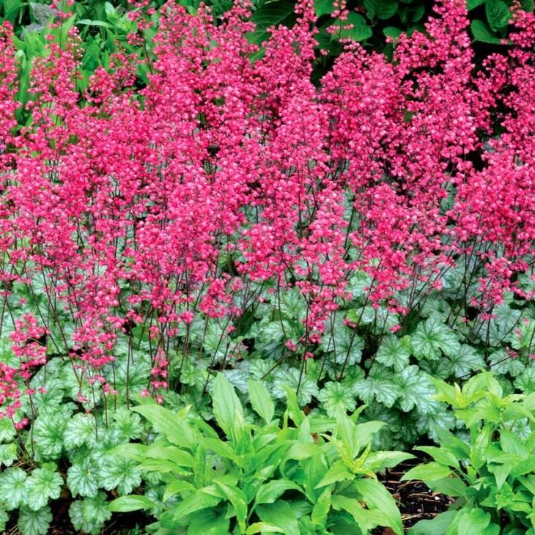
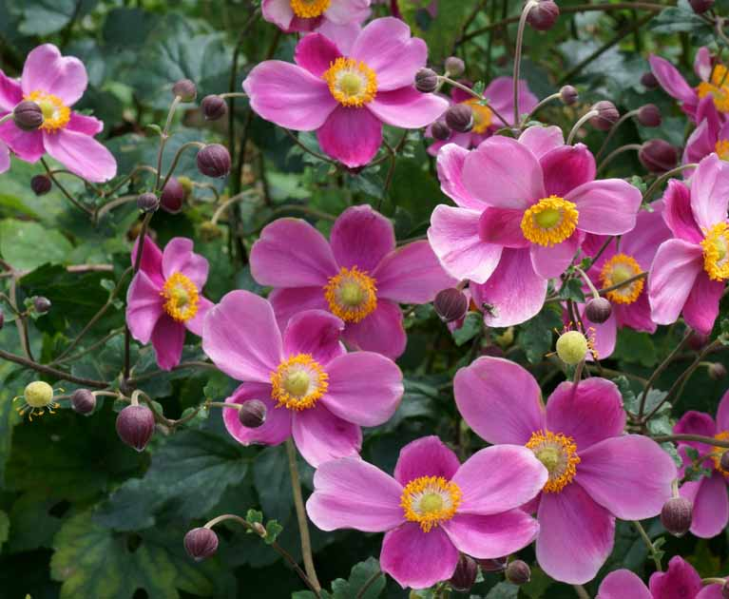
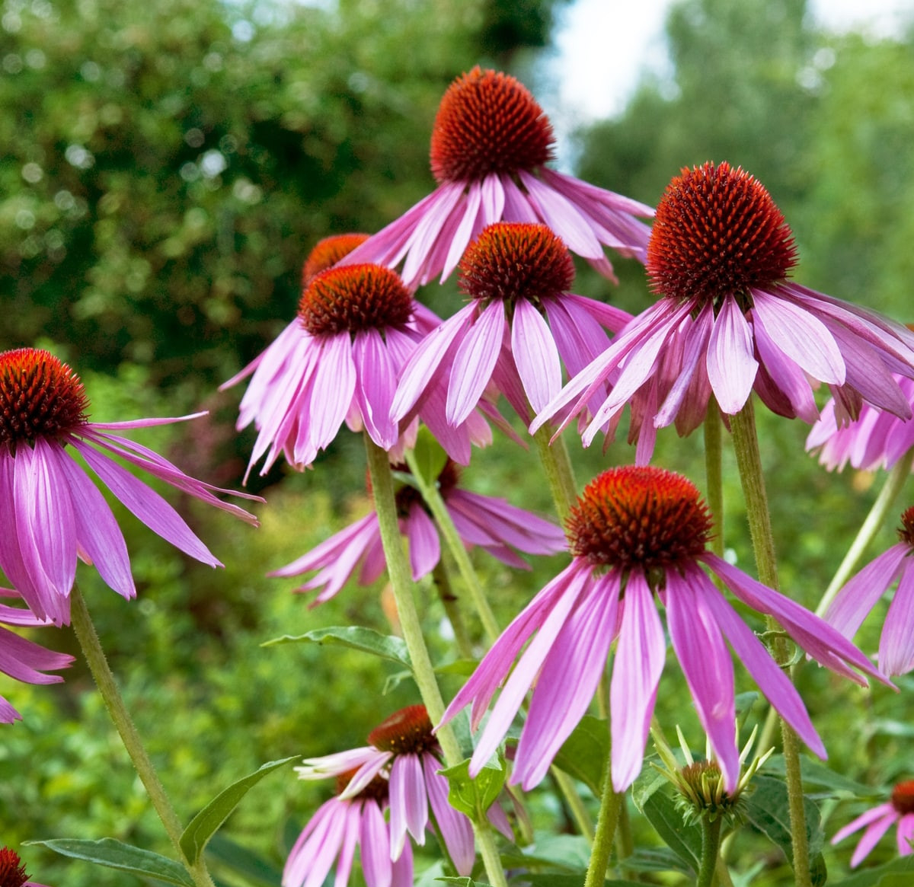
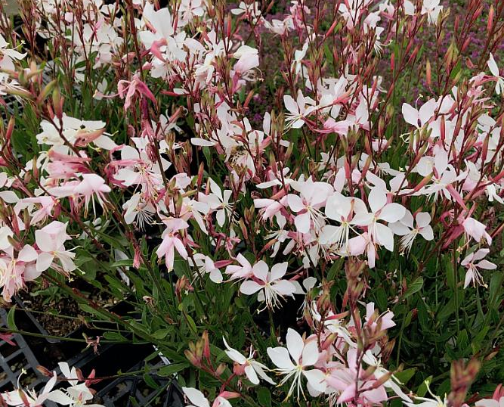
RED BANK PARKLET – PLANTINGS
Parklet planting area will be surrounded by an iron tree guard on three sides except the roadside.
Plantings include:
  Sunburst Honey Locust
  Overdam Feather Reed Grass
  Sweet Flag
  Red Head
  Paris Coral Bells
  Japanese Anemone
  Purple Coneflower
  Whirling Butterflies

Slide 8
QUESTIONS?

